Slide 1
Body Paragraphs

Slide 2
Body Paragraphs
Each body paragraph of an argumentative essay should have four parts – a topic sentence that
states an argument; an introduction to the evidence; the evidence; and then an explanation of
how this supports your argument and also proves your thesis.

Slide 3
Body Paragraphs
Stating your Argument
A reason why … main claim … is true is because … state your argument ….
... State your argument ... demonstrates that … main claim … is true.
Introducing your Evidence
What readers should understand is that … explain the context (who, what, where, & when ….
To better understand the situation … explain the context (who, what, where, & when ….
Stating the Evidence
In the article …”title of the article” by (name of the author … it states that, “ … ”.
In the historical document …”title of the article” by (name of the author … it states that,________”.
Let’s look at one example, what happens is …explain the experience that shows how your
argument is true…. .
Connect Evidence to Thesis, (Unpack your Evidence)
This evidence illustrates that …restate main claim in a different way… is true because _________.
This experience illustrates that …restate main claim in a different way… is true because _______.
This historical document illustrates that…restate main claim in a different way… is true because
_________________.

Slide 4
Sample Body Paragraph
Like most federal agencies, the National Park Service faces serious budget constraints. Funds that should be used to preserve Yellowstone National Park and its wildlife have been diverted to deal with the snowmobile issue. A single environmental impact study of the problem cost taxpayers nearly $250,000 in early 2002 (Greater Yellowstone Coalition), and the park service estimates that implementing the new plan would cost one million dollars (“Snowmobile” B25). Also, park rangers are spending an increasing amount of their valuable time policing snowmobilers. In 2002, park rangers issued 338 citations for illegal snowmobiling activity, twice as many as in 2001, in addition to hundreds of warnings (Greater Yellowstone Coalition). Although most snowmobilers remain law-abiding, a disturbing number of joyriders violate speed limits, stray from marked trails, and pursue animals for the thrill of the chase. Policing such activities takes away from park rangers’ primary responsibility—preserving this country’s treasured natural resources.
Sample taken from (dianahacker.com)

Slide 5
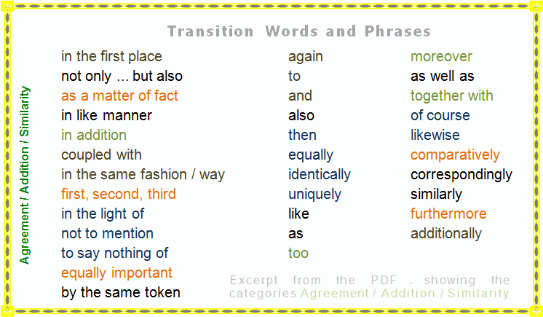
More Transition Words

